Slide 1
FINITE AND NON FINITE VERBS

Slide 2
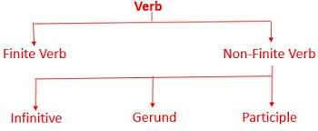

Slide 3
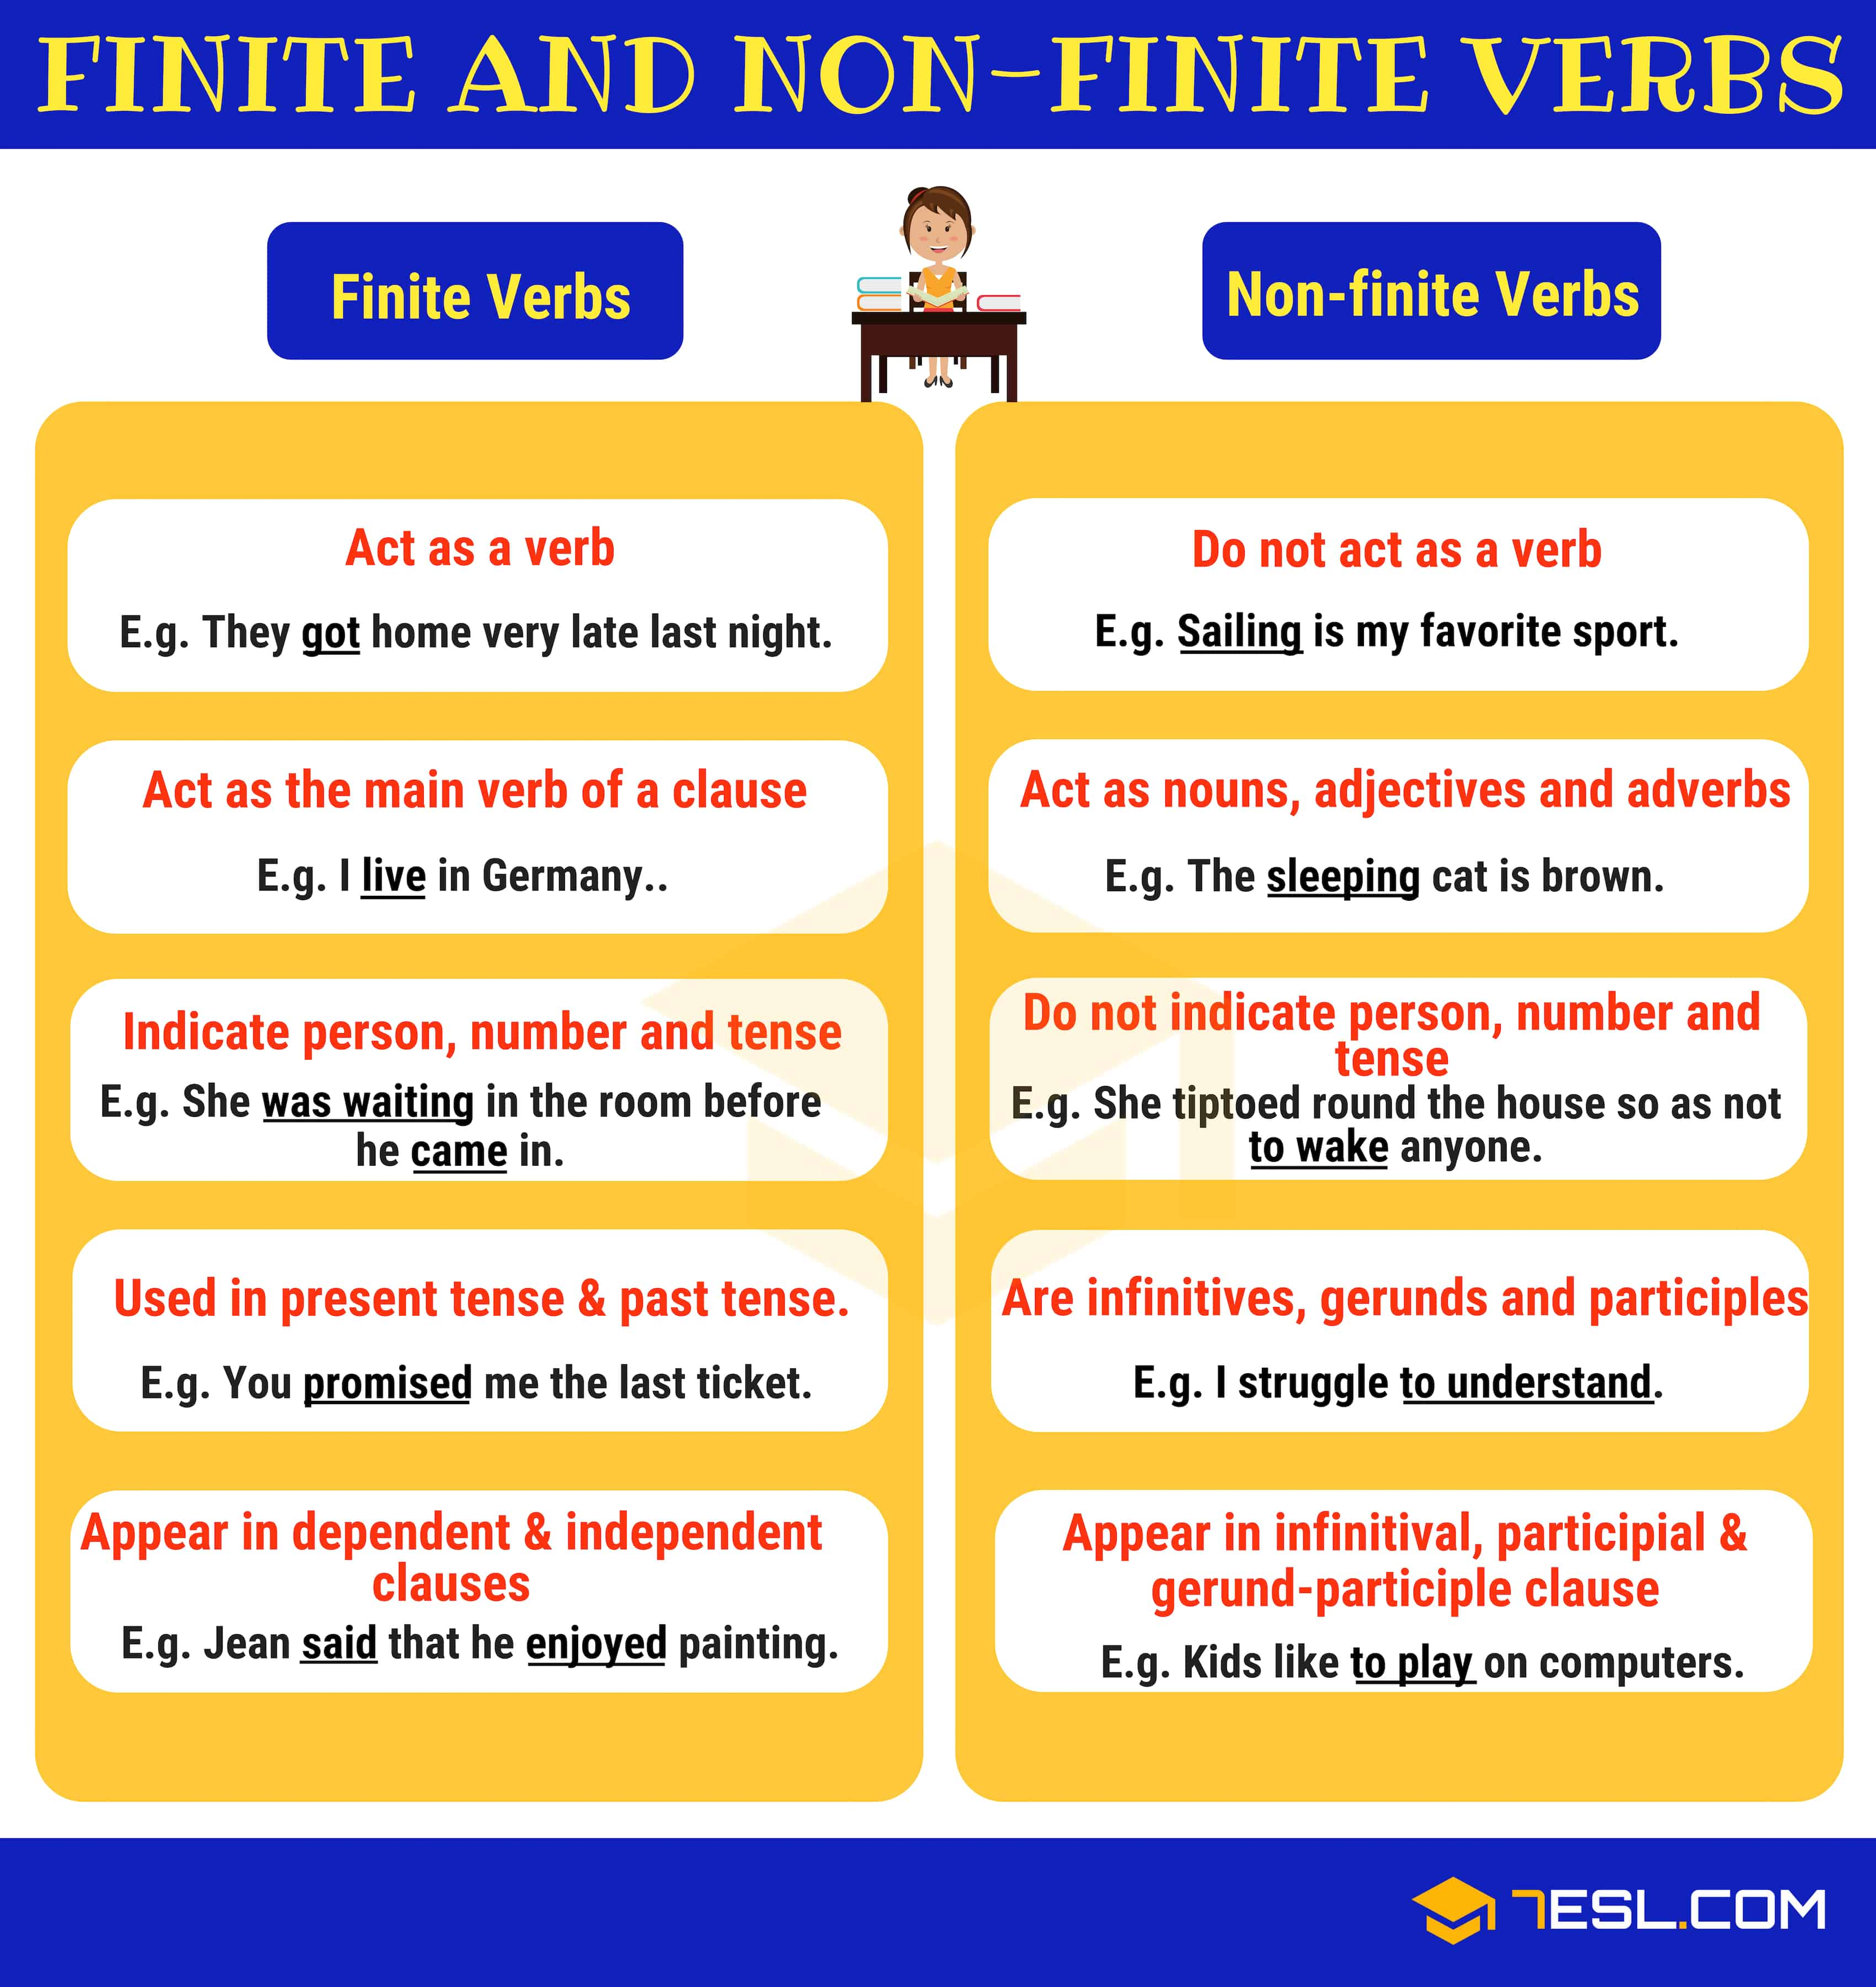

Slide 4
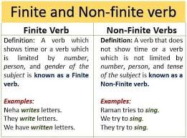
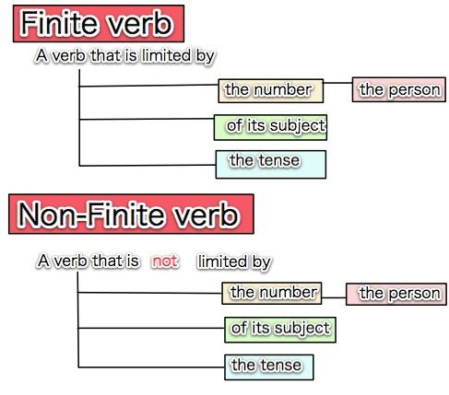

Slide 9
GOEBBELS

Slide 12
REFERENCES & THANKING SLIDE

